Slide 1
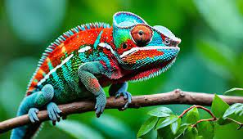
The Deep Learning Chameleon
How Adaptability Mirrors Deep Learning - A CNN+RNN hybrid
TEAM: Tensor Titans-(Annette Bazan, Elizabeth Martinez, Elijah Ghaya, and Yammine Gabriel Yammine)
ITAI 2376 Deep Learning
Dr. Awodogan

Slide 2
Neural Networks & Deep Learning
A neural network is an artificial system inspired by the human brain.
It learns from data by adjusting internal parameters.
Deep Learning is a subset of machine learning that uses multi layered neural networks to solve complex problems.
Just like an animals’ brain learns from experience, neural networks improve over time by recognizing patterns in data.

Slide 3
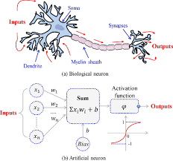
Structure of a Neuron
Biological Neuron:
The brain consists of neurons that send electrical signals
Each neuron has dendrites (input) a cell body (processing unit) and an amazon(output signal)
Artificial Neuron(Perceptron):
Inputs -> Weighted Sum -> Activation Function -> Output
Similar to how neurons in a brain fire when they reach a threshold

Slide 4
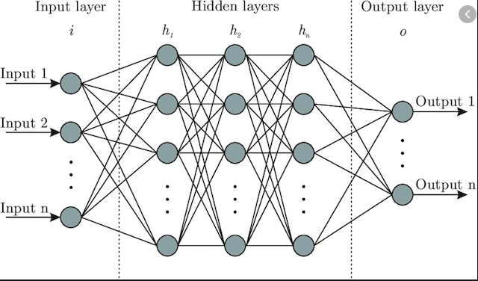
How Neurons Form a Network
01
INPUT LAYER: Takes in raw data (like eyes detecting colors= CNN input layer)
02
HIDDEN LAYERS: Extract features and makes sense of the data( like a chameleon’s brain analysing surroundings RNN layer processes past conditions and reinforcement learning choosing the best action based on context.)
03
OUTPUT LAYER: Makes decisions( like a chameleons choosing the right color to blend in)

Slide 5
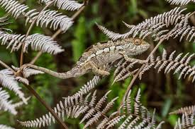
Why a Chameleon Represents a CNN + RNN hybrid
SKIN PIGMENT SHIFTS = Adjusting Weights
The way a chameleon adjusts skin cells to match its surroundings is like how neural networks adjust weights for better predictions. The chameleon makes real-time changes to match its environment just like a hybrid of CNN + RNN or reinforcement learning models make adaptive decisions in dynamic environments.
ADAPTABILITY = Learning from Data
A chameleon changes colors based on environment, just like a neural network updates weights to improve performances. RNNs(Recurrent Neural Network) & Transformers adjust based on past inputs similar to how chameleons remember and react dynamically
INDEPENDENT EYE MOVEMENT = Multi-Input Processing
Chameleons move their eyes independently, processing multiple inputs at once which is similar to neural networks analyzing images, text, or audio simultaneously. CNNs(Convolutional Neural Networks) excel at image processing and pattern recognition which is similar to how chameleon’s analyze their environment.
CNNs process local image features and RNNs handle sequential decisions, mimicking the chameleon’s behavior.

Slide 6
Applications of Neural Networks (real-world examples)
COMPUTER VISION: Just as a chameleon detects surroundings, neural networks recognize objects in images like facial recognition, self-driving cars etc.
SPEECH & LANGUAGE PROCESSING: Neural networks help understand language like a chameleon processes different environments.
GAME AI & ROBOTICS: Neural networks allow AI to adapt similar to how chameleons respond to their surroundings.

Slide 7
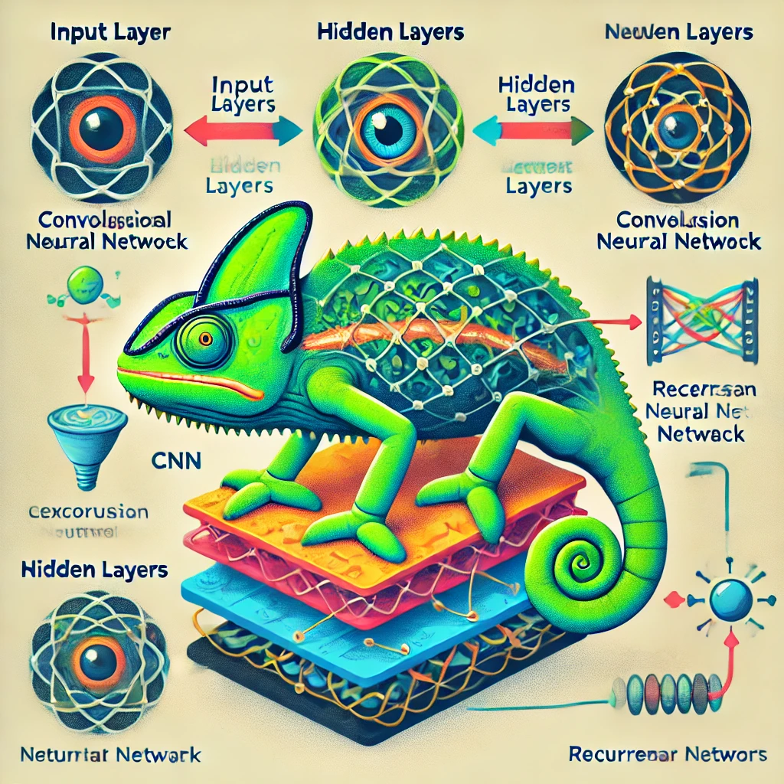
CONCLUSION
Neural networks like chameleons are highly adaptable and capable of pattern recognition.
The biological mechanisms of a chameleon mirror key principles of deep learning. CNN for Vision like the eyes of a chameleon, CNNs excel at image processing and spatial recognition.
RNN(Transformer) for adaptability the way a chameleon remembers past conditions and adjusts in real-time is similar to RNNs which process sequences of data over time.
Reinforcement Learning for decision-making Chameleons don’t change color just for camouflage it is also used for regulating temperature and communicate just like how a neural networks have multiple applications

Slide 8
REFERENCES:
CNN- An Introduction to Convolutional Neural Networks: A Comprehensive Guide to CNNs in Deep Learning | DataCamp
RNN- Understanding CNN vs RNN in Deep Learning: The Essential Differences That Can Transform Your AI Projects
Key Differences Between CNNs and RNNs in Deep Learning
HYBRID-Constructing a Hybrid CNN-RNN Model for Time-Series Analysis in PyTorch - Sling Academy

